Slide 1

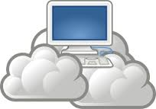
Cloud Computing

Slide 2
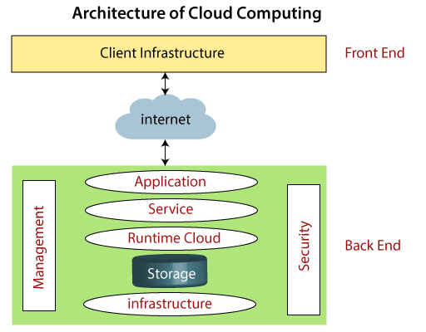
Cloud Computing Architecture

Slide 3
Components
Cloud computing architecture is divided into the following two parts -
Front End
The front end is used by the client. It contains client-side interfaces and applications that are required to access the cloud computing platforms. The front end includes web servers (including Chrome, Firefox, internet explorer, etc.), thin & fat clients, tablets, and mobile devices.
Back End
The back end is used by the service provider. It manages all the resources that are required to provide cloud computing services. It includes a huge amount of data storage, security mechanism, virtual machines, deploying models, servers, traffic control mechanisms, etc.

Slide 4
Components
There are the following components of cloud computing architecture -
1. Client Infrastructure
Client Infrastructure is a Front-end component. It provides GUI (Graphical User Interface) to interact with the cloud.
2. Application
The application may be any software or platform that a client wants to access.
3. Service
A Cloud Services manages that which type of service you access according to the client’s requirement.

Slide 5
Components
Cloud computing offers the following three type of services:
i. Software as a Service (SaaS) – It is also known as cloud application services. Mostly, SaaS applications run directly through the web browser means we do not require to download and install these applications.
Some important example of SaaS is given below –
Example: Google Apps, Salesforce Dropbox, Slack, HubSpot, Cisco WebEx.

Slide 6
SaaS (Software as a Service).
SaaS platforms make software available to users over the internet, usually for a monthly subscription fee.
SaaS Delivery:
Over the internet.
SaaS Advantages:
With SaaS, you don’t need to install and run software applications on your computer (or any computer).
Everything is available over the internet when you log in to your account online.
You can usually access the software from any device, anytime (as long as there is an internet connection).

Slide 7
SaaS (Software as a Service).
SaaS Advantages:
The same goes for anyone else using the software. All your staff will have personalized logins, suitable to their access level.
It’s all taken care of in the Cloud.
Another key advantage is the payment structure.
Most subscriptions include maintenance, compliance, and security services, which can be time-consuming and costly when using on-premise software.

Slide 8
SaaS (Software as a Service).
When to Use SaaS:
Take your email server, for example.
You want to ensure that you can continue to send and receive emails without needing to adjust your email settings or worry about updates.
Imagine if your email server failed because you forgot to update it, leaving you without email access for days. That’s simply not an option in today’s marketplace.
If you use a SaaS platform to run your email inbox, the chances of something going wrong are very small.
And if something did go wrong, it would be up to the SaaS provider to find a solution.

Slide 9
SaaS (Software as a Service).
SaaS Characteristics:
SaaS platforms are:
Available over the internet.
Hosted on a remote server by a third-party provider.
Scalable, with different tiers for small, medium, and enterprise-level businesses.
Inclusive, offering security, compliance, and maintenance as part of the cost

Slide 10
Components
ii. Platform as a Service (PaaS) – It is also known as cloud platform services. It is quite similar to SaaS, but the difference is that PaaS provides a platform for software creation, but using SaaS, we can access software over the internet without the need of any platform.
Example: Windows Azure, Force.com, Magento Commerce Cloud, OpenShift.

Slide 11
PaaS (Platform as a Service).
A PaaS vendor provides hardware and software tools over the internet, and people use these tools to develop applications. PaaS users tend to be developers.
PaaS Delivery:
Over the internet.
PaaS Advantages:
PaaS is primarily used by developers who are building software or applications.
This means developers don’t need to start from scratch when creating applications, saving them a lot of time (and money) on writing extensive code.

Slide 12
PaaS (Platform as a Service).
PaaS Characteristics:
PaaS platforms are:
Accessible by multiple users.
Scalable – you can choose from various tiers of resources to suit the size of your business.
Built on virtualization technology.
Easy to run without extensive system administration knowledge.

Slide 13
PaaS (Platform as a Service).
When to Use PaaS:
PaaS is often the most cost-effective and time-effective way for a developer to create a unique application.
PaaS allows the developer to focus on the creative side of app development, as opposed to menial tasks such as managing software updates or security patches.
All of their time and brainpower will go into creating, testing, and deploying the app.

Slide 14
Components
iii. Infrastructure as a Service (IaaS) – It is also known as cloud infrastructure services. It is responsible for managing applications data, middleware, and runtime environments.
Example: Amazon Web Services (AWS) EC2, Google Compute Engine (GCE), Cisco Metapod.

Slide 15
IaaS (Infrastructure as a Service).
IaaS businesses offer services such as pay-as-you-go storage, networking, and virtualization.
IaaS gives users cloud-based alternatives to on-premise infrastructure, so businesses can avoid investing in expensive on-site resources.
IaaS Delivery:
Over the internet.

Slide 16
IaaS (Infrastructure as a Service).
IaaS Advantages:
Maintaining on-premise IT infrastructure is costly and labor-intensive.
It often requires a significant initial investment in physical hardware, and then you will probably need to engage external IT contractors to maintain the hardware and keep everything working and up-to-date.
IaaS solutions are highly flexible and highly scalable, and you can replace it whenever you need without losing money on your initial investment.

Slide 17
IaaS (Infrastructure as a Service).
IaaS Characteristics:
IaaS platforms are:
Highly flexible and highly scalable.
Accessible by multiple users.
Cost-effective.

Slide 18
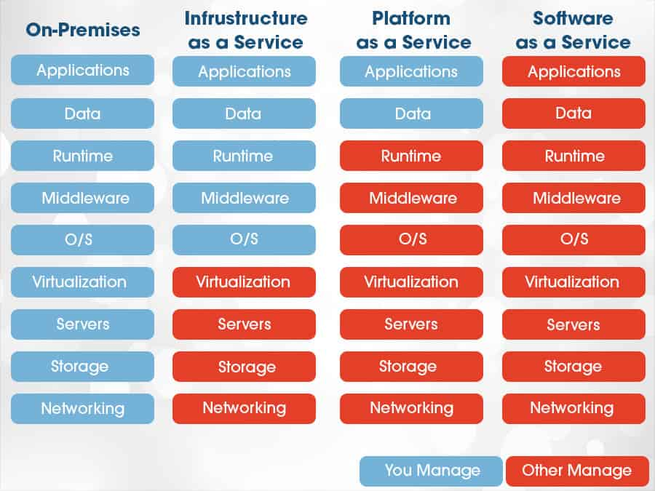
On-Premises vs IAAS vs PAAS vs SAAS

Slide 19
Components
4. Runtime Cloud
Runtime Cloud provides the execution and runtime environment to the virtual machines.
5. Storage
Storage is one of the most important components of cloud computing. It provides a huge amount of storage capacity in the cloud to store and manage data.

Slide 20
Components
6. Infrastructure
It provides services on the host level, application level, and network level. Cloud infrastructure includes hardware and software components such as servers, storage, network devices, virtualization software, and other storage resources that are needed to support the cloud computing model.
7. Management
Management is used to manage components such as application, service, runtime cloud, storage, infrastructure, and other security issues in the backend and establish coordination between them.

Slide 21
Components
8. Security
Security is an in-built back-end component of cloud computing. It implements a security mechanism in the back end.
9. Internet
The Internet is medium through which front end and back end can interact and communicate with each other.

